Slide 1
UML Diagrams
Class Diagrams, Sequence Diagrams

Slide 2
Iteration 3: Class Diagram

Slide 3
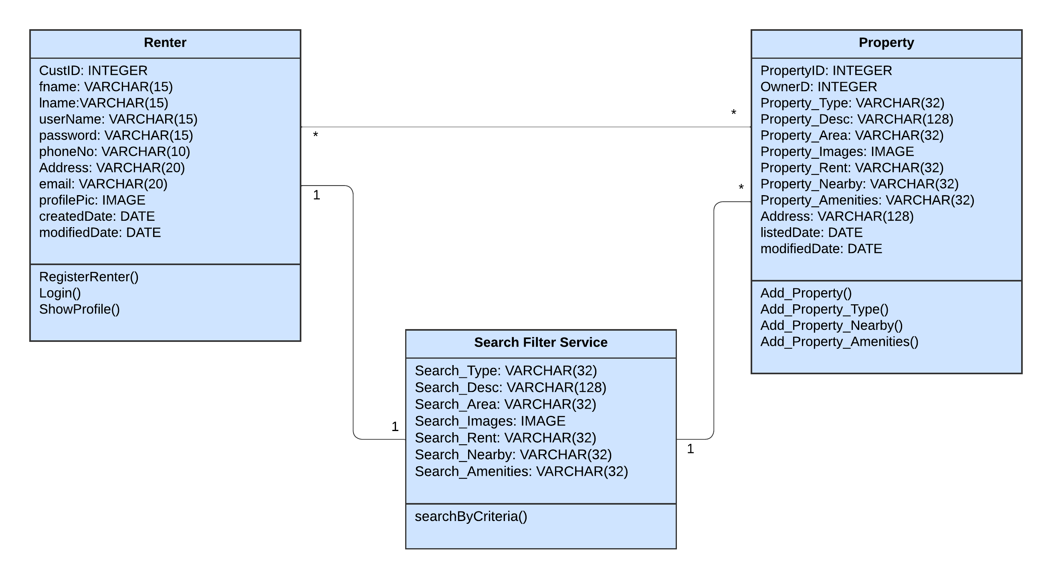
01.03 Search By Criteria

Slide 4
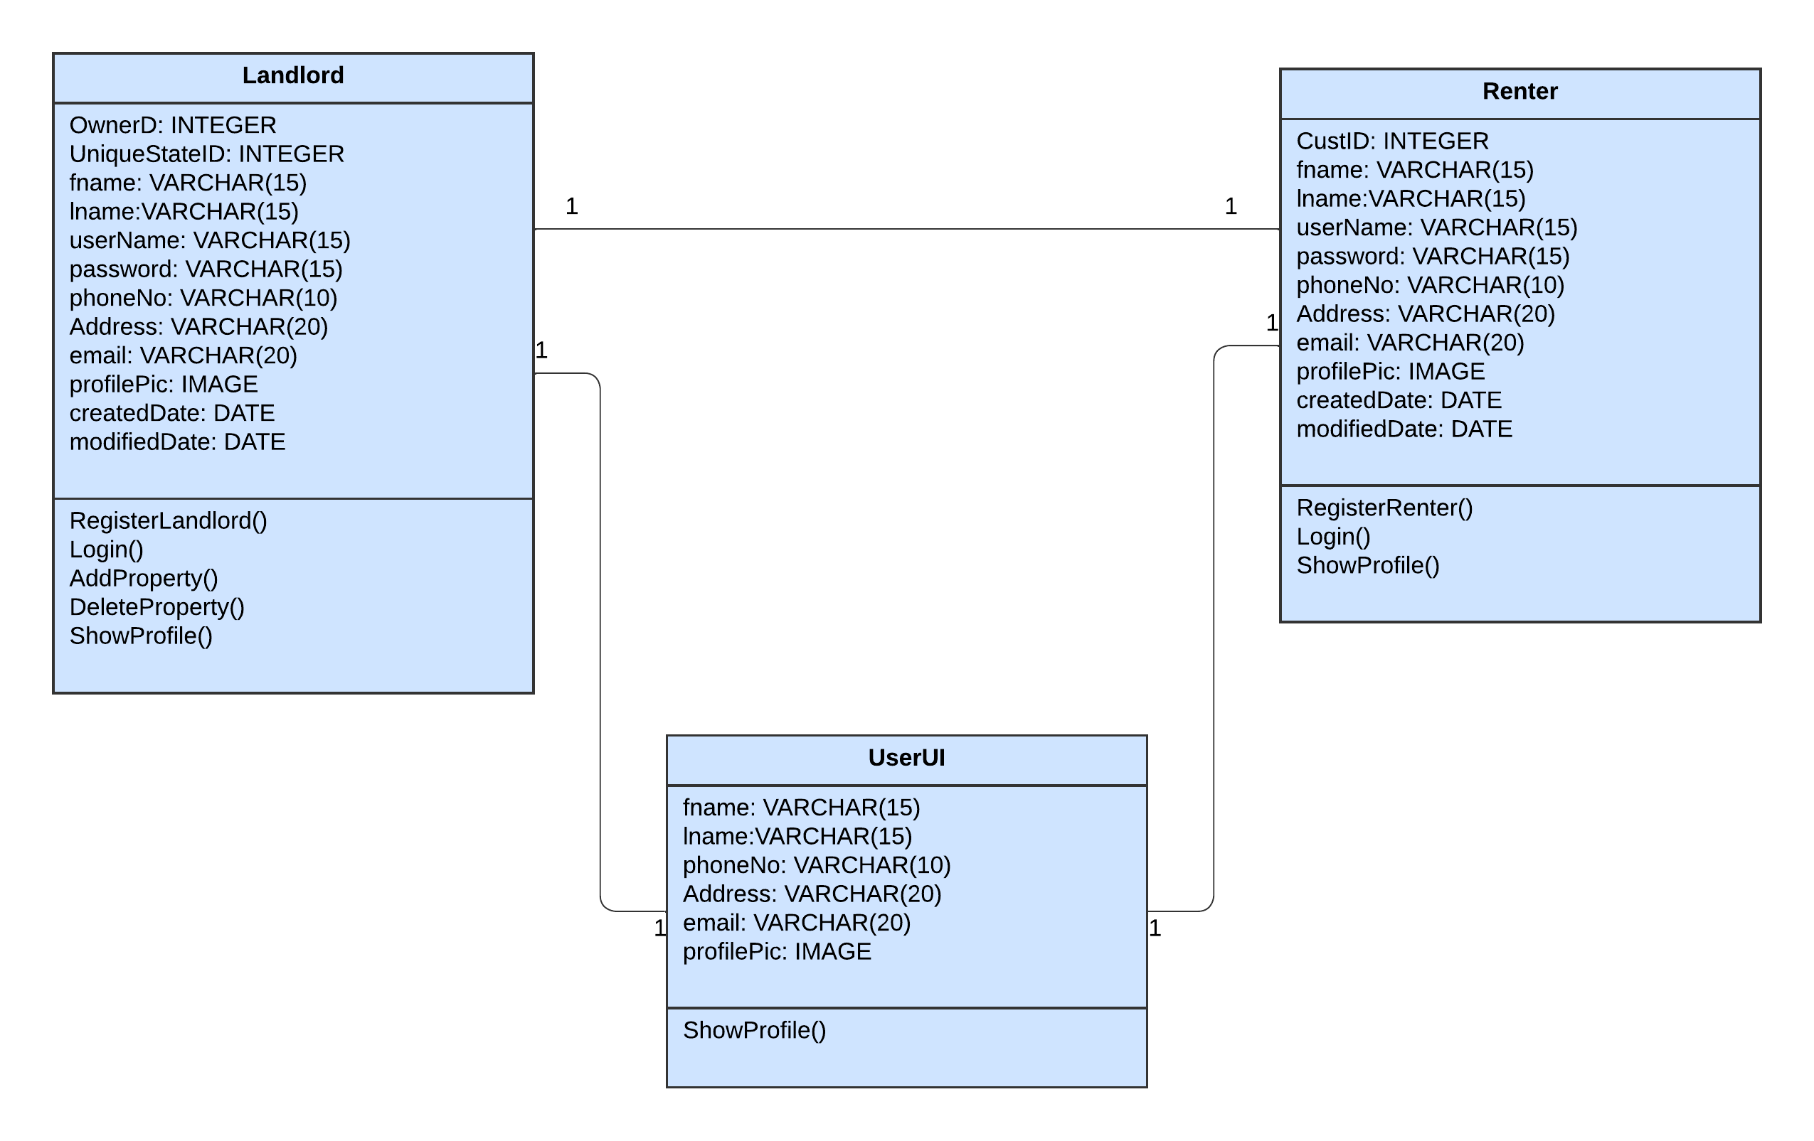
04.05 Show Contact Info

Slide 5
Iteration 3: Sequence Diagram

Slide 6
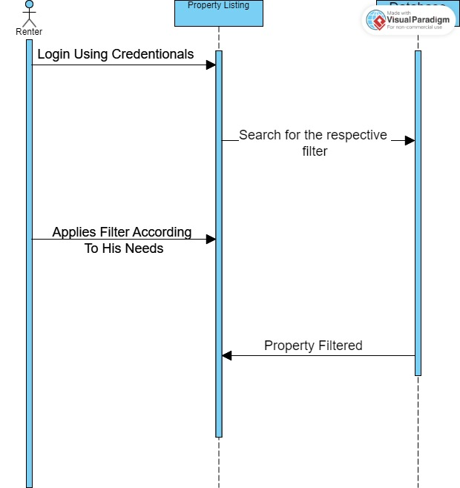
01.03 Search By Criteria

Slide 7
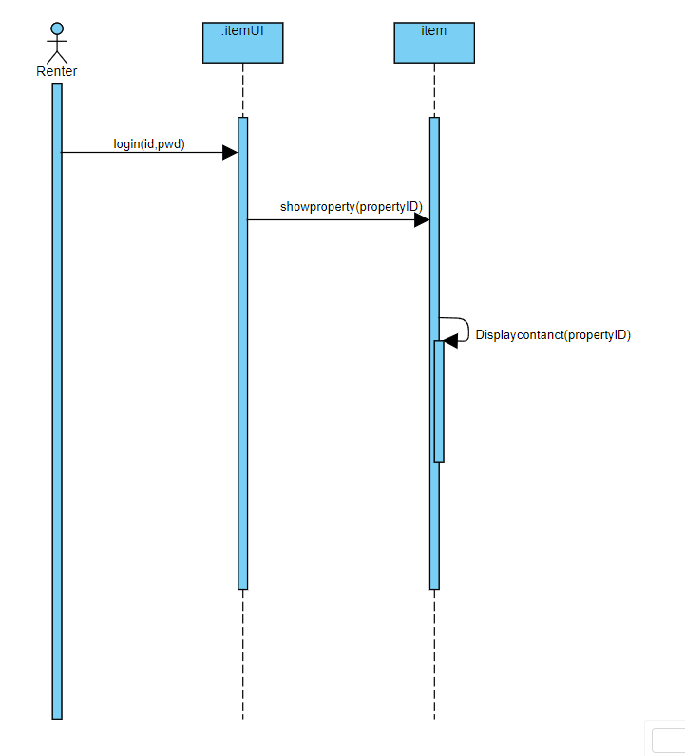
04.05 Show Contact Info

Slide 8
Iteration 4
Class Diagrams

Slide 9
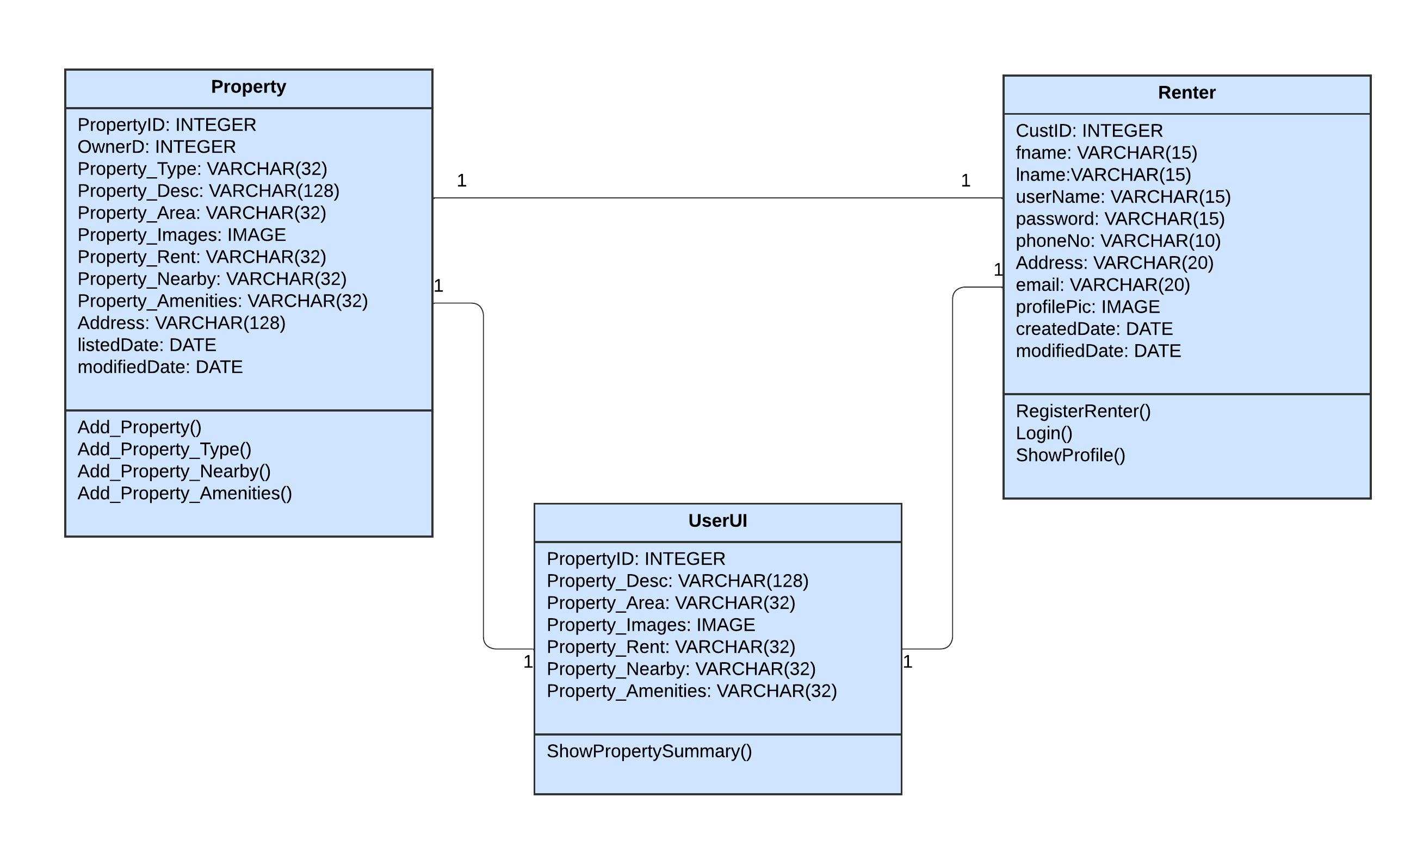
04.04 Show Property Summary

Slide 10
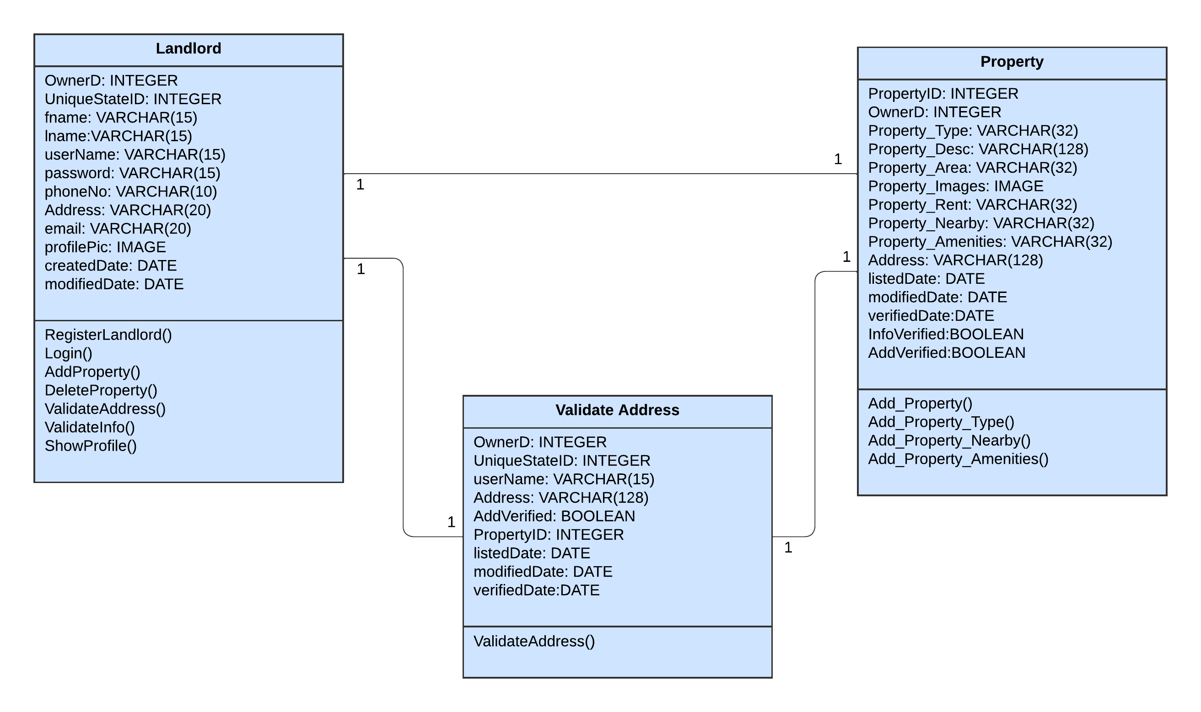
05.01 Validate Address

Slide 11
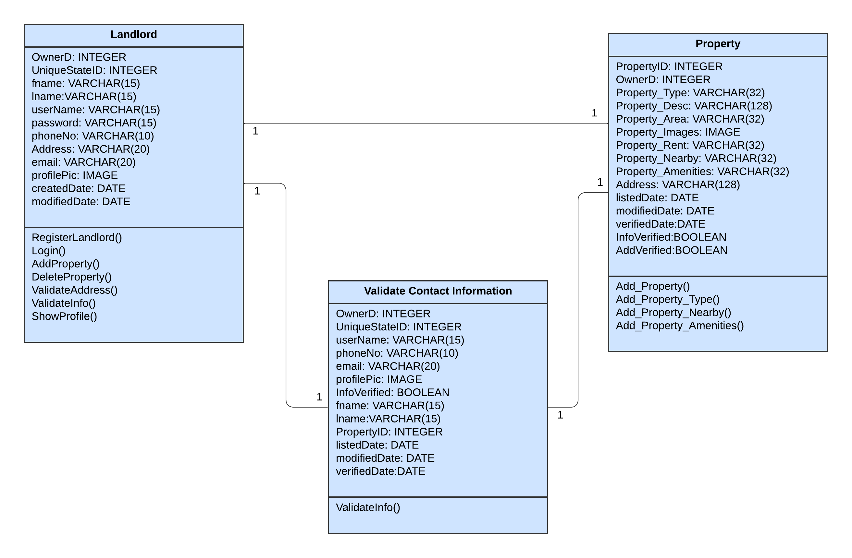
05.02 Validate Contact Info

Slide 12
Iteration 4
Sequence Diagrams

Slide 13

04.04 Show Property Summary
1. The use case begins when the Actor accesses the property details page.
2. (Join Point: ET-Ex - External Entitlements) The system validates the Actor's external entitlements to ensure they have the necessary permissions to view property details.
3. (Join Point: DF-In - Data Flow In) The system fetches the property details, including its summary, from the database.
4. The Actor is presented with a summary of the property, which includes essential details such as the property name, type, location, price, and a thumbnail image.
5. The Actor has the option to view additional details or take further actions, such as show contact detail for the property owner, or navigating to other related pages.
Register renter
Property
UserUi
Login()
Showproperty_summary()
Property_Information()

Slide 14
05.01 Validate Address
The use case begins when the Actor navigates to the address validation section.
The system validates the Actor's external entitlements to ensure they have the necessary permissions to validate address. (JP: ET-Ex)
The system prompts the Actor to enter the property address for validation.
Actor enters the property address in the provided fields. (JP: DF-IN)
The system initiates the address validation process, checking the provided address against a set of predefined validation criteria.
If the address is successfully validated, the system updates the property information with the validated address.
If the validation process encounters limitations (e.g., unsupported formats or regions), the system flags the address and informs the Actors. (JP: DF-Out)
The system encourages the Actor to provide accurate information and offers guidance on accepted address formats.
Actor has the option to make corrections and reattempt the validation or proceed with the potentially limited address.
Register Landlord
Property
Validate address
information
Login()
Validate_ address()
Validation()
Greentick_address()

Slide 15
05.02 Validate Contact Info
The Actor (Landlord) logs into the "StayMatch" website. (JP: FV)
System validates the data dependencies for the Landlord's account. (JP: DDV)
The Actor navigates to the other party’s contact information previously accessed through the "Show Contact Info" feature.
The Actor selects the option to validate the contact information provided by the system. The system prompts the Actor to verify each contact detail (e.g., email, phone number) for accuracy. (JP: DF-Out)
The Actor confirms the correctness of each contact detail.
Register Landlord
Property
Validate contact information
Login()
Validate_Info()
Greentick_contact()

